Slide 1



MALWARE DETECTION
USING ML
PRESENTED BY
Satyapriya Tripathy
Reg No - 2505260021
MCA
GUIDED BY
Asst prof. Bibhudendu Panda

Slide 2
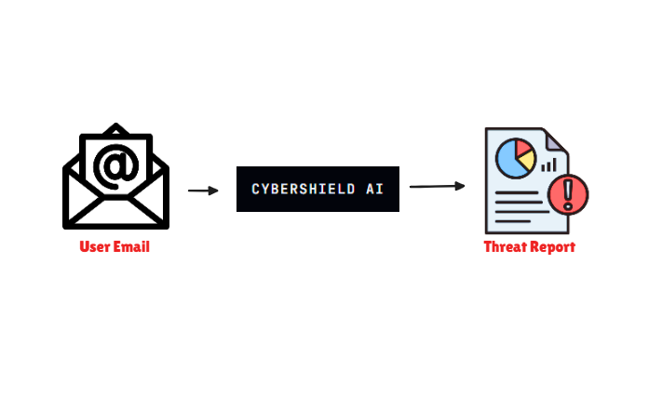
PROBLEM STATEMENT
EXISTING PROBLEM
OBJECTIVE
• Millions of phishing and spam emails are sent daily.
• Users often click malicious links unknowingly.
• Traditional filtering systems fail to explain threats.
• Small organizations lack affordable threat detection systems.
Develop an AI-powered system capable of:
Spam Detection
Phishing Detection
URL Analysis
Threat Classification
Explainable Security Insights

Slide 3
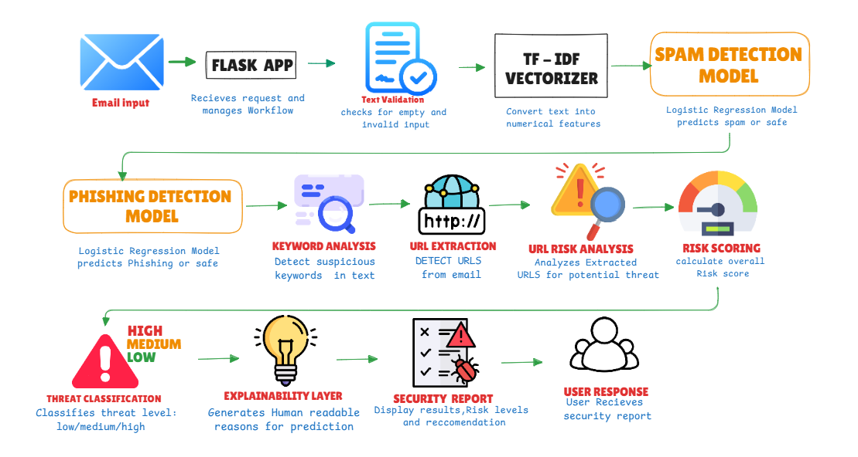
SYSTEM ARCHITECTURE

Slide 4
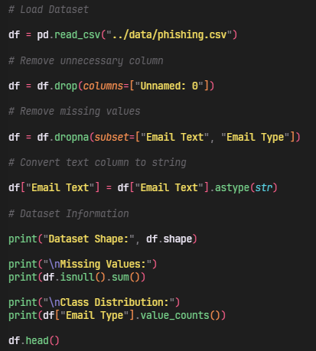
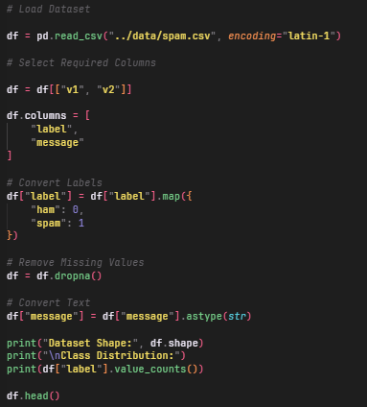
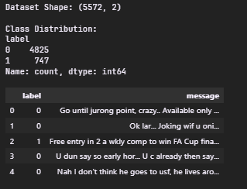
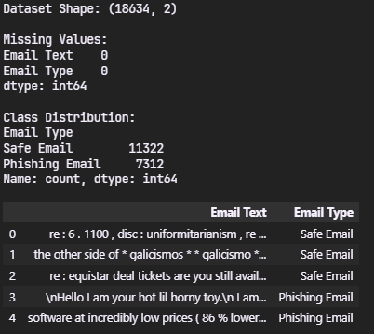
Phising.csv
Spam.csv
The Phishing Dataset contains labeled email samples used to train the phishing detection model.
Email Type:
• 0 → Legitimate Email
• 1 → Phishing Email
Email Text:
• The email content containing either normal communication or phishing indicators used for threat detection.
The Spam Dataset consists of labeled email and SMS messages used to train the spam detection model.
Email Type:
• 0 → Safe (Legitimate Message)
• 1 → Spam (Unwanted or Promotional Message)
Email Text:
• The actual content of the message used as input for machine learning training and classification.
DATASET & DATA COLLECTION

Slide 5
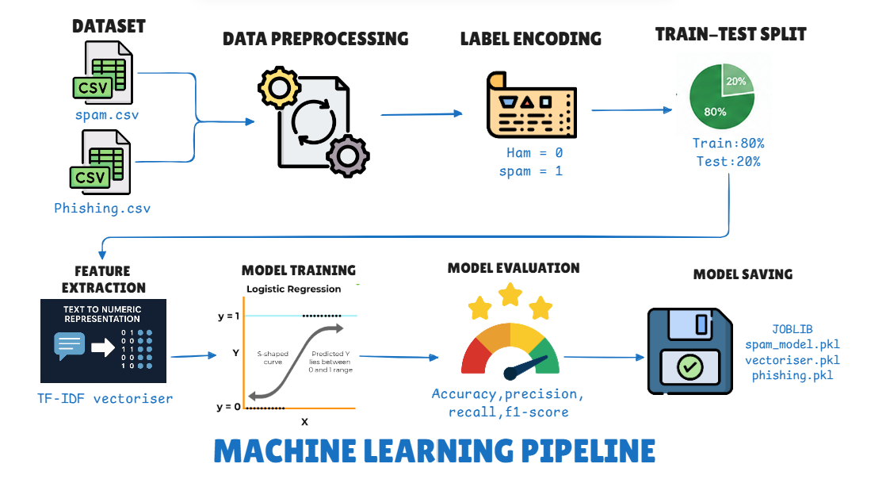

Slide 6
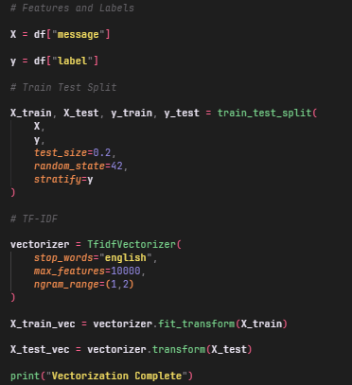
FEATURE ENGINEERING
• The dataset was divided into Features (X) and Labels (y).
• An 80:20 Train-Test Split was performed to train the model on historical data and evaluate its performance on unseen data.
• Stratified sampling was used to maintain the original class distribution in both training and testing datasets.
• TF-IDF (Term Frequency–Inverse Document Frequency) Vectorization was applied to transform textual email content into numerical feature vectors.
• The vectorized data was then used as input for machine learning model training.
Variable Type | Column Name | Purpose
Feature (X) | message | Email/SMS text used for training
Target (y) | label | Class label to be predicted
First, we separated the email text from its corresponding labels. The dataset was then split into training and testing sets using an 80:20 ratio. To convert textual data into a machine-readable format, we applied TF-IDF vectorization, which assigns importance scores to words based on their frequency and relevance. These numerical features were then used to train our Logistic Regression model.

Slide 7
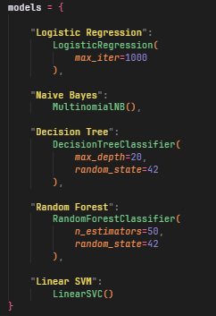
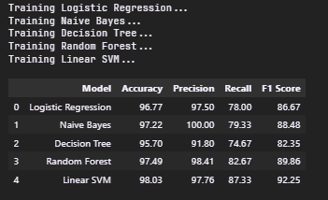
MODEL TRAINING
Model Definition
To identify the most effective classification algorithm, multiple machine learning models were trained and evaluated on the same dataset.
The models tested included Logistic Regression, Naive Bayes, Decision Tree, Random Forest, and Linear SVM. Each model was trained using TF-IDF feature vectors generated from the email content.
Their performance was compared using Accuracy, Precision, Recall, and F1 Score metrics to determine the most suitable model for deployment.
The evaluation process measured the ability of each model to correctly classify malicious and legitimate messages.
Accuracy was used to measure overall correctness, while Precision, Recall, and F1 Score provided deeper insights into threat detection performance and classification reliability.
O/P after Model training

Slide 8
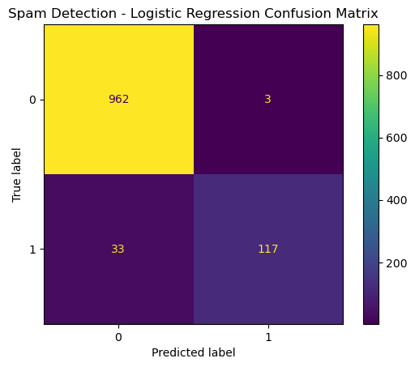
Instead of directly choosing a model, we evaluated five different machine learning algorithms. Each model was trained using the same TF-IDF feature set and tested on unseen data. After comparing Accuracy, Precision, Recall, and F1 Score, Logistic Regression demonstrated the best balance between performance and efficiency, making it the most suitable model for CyberShield AI.
Based on the evaluation results, Logistic Regression was selected as the final model for CyberShield AI.
Reasons for Selection:
• Strong Precision and Recall scores
• Fast training and prediction speed
• Low computational overhead
• Excellent compatibility with TF-IDF features
• Easy deployment using Joblib serialization
MODEL
SELECTION

Slide 9
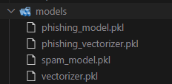
MODEL PERSISTENCE (JOBLIB)
WHAT EACHFILE REPRESENTS
File | Purpose
spam_model.pkl | Trained Logistic Regression model for spam detection
phishing_model.pkl | Trained Logistic Regression model for phishing detection
vectorizer.pkl | TF-IDF vectorizer used for spam emails
phishing_vectorizer.pkl | TF-IDF vectorizer used for phishing emails
After training and evaluating the machine learning models, the final models were serialized using the Joblib library.
The trained Spam Detection Model, Phishing Detection Model, and TF-IDF Vectorizers were saved as .pkl files. This allows the application to load pre-trained models directly during runtime without retraining them every time the system starts.
Model persistence significantly reduces startup time, improves deployment efficiency, and enables seamless integration with the Flask web application.

Slide 10
RESULTS & FUTURE SCOPE
Current Achievement | Future Enhancement
Spam & Phishing Detection using Logistic Regression | Malware Detection using AI
Real-Time Threat Analysis through Flask Application | Enterprise Security Dashboard with Threat Intelligence

Slide 11
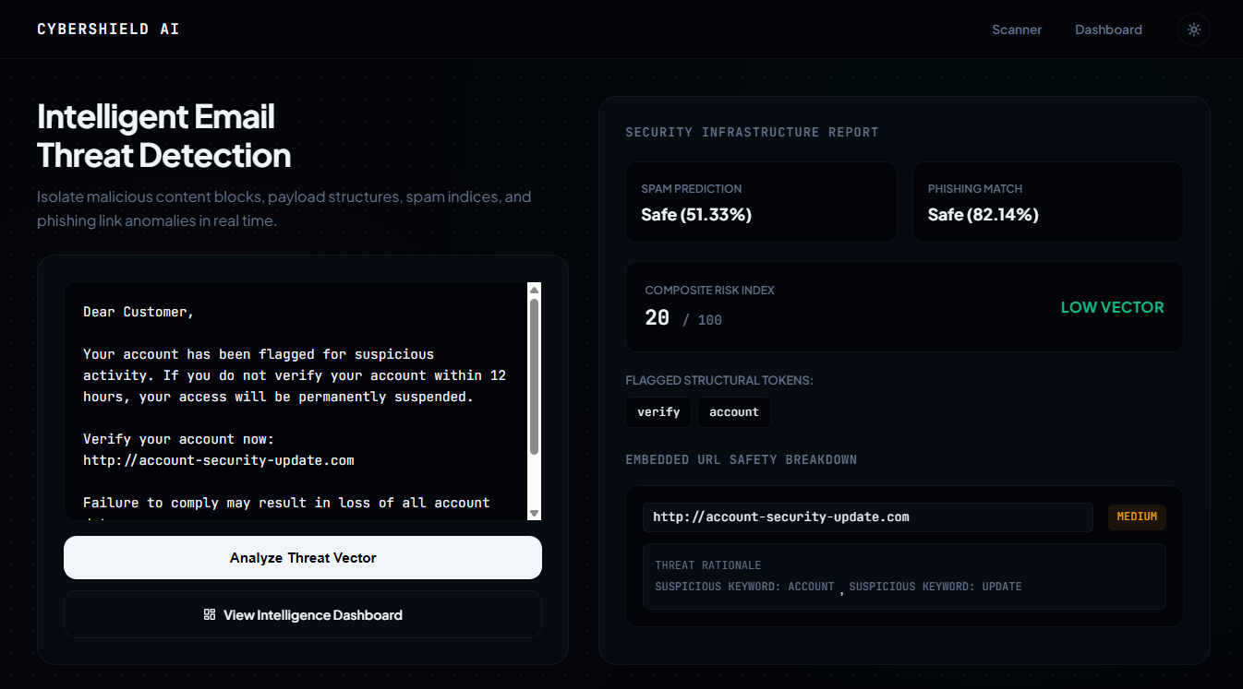
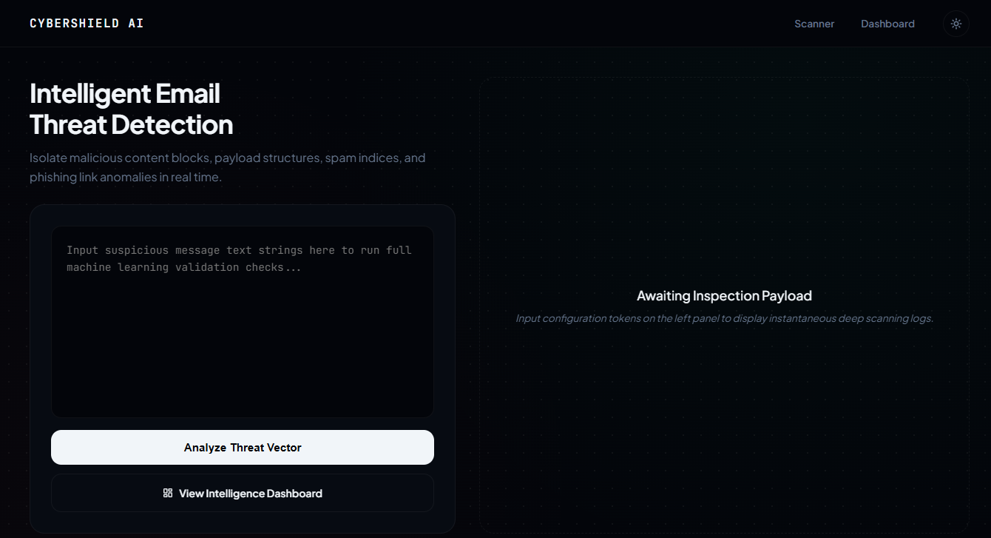
THANK YOU
Liceria & Co.
DEMO LINK
9337566648
satyapt001@gmail.com
GitHub

